Slide 1

Acoustic Amplifier for Underwater Communication
by: Venkat Kommina (2022eeb1225),
P. Jayavardhan (2022eeb1328)
Under the guidance of Dr. Sam Darshi Sir

Slide 2
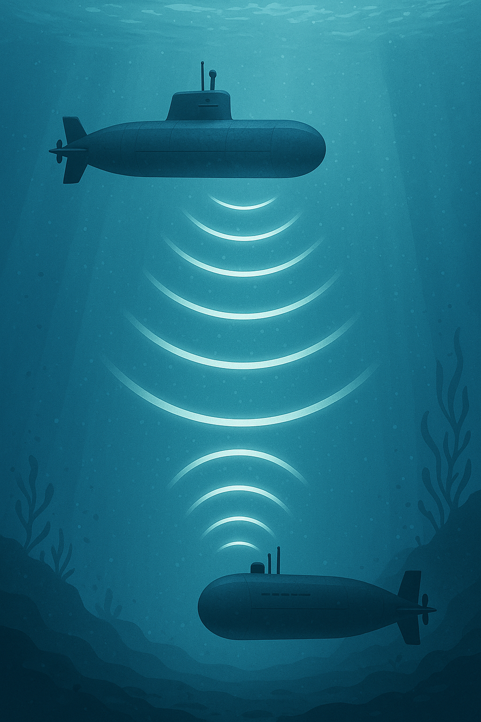
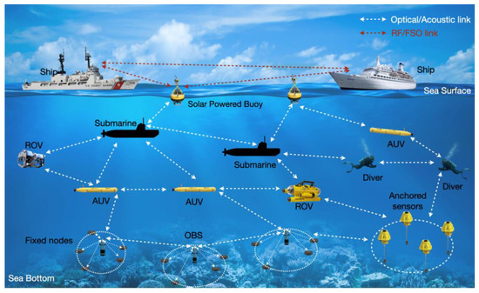
Enables real-time communication with submarines, autonomous underwater vehicles (AUVs), and divers for ocean mapping, data collection, and deep-sea discovery.
Defense & Surveillance – Critical for naval operations, underwater drone coordination, and secure data transmission between submarines and surface ships.

Slide 3
Problem Statement:
Acoustic Amplifier for Underwater Communication
Hydrophones generate extremely weak signals (in microvolts).
These signals are too faint and noisy for direct use.
Therefore, we first need a preamplifier to boost the signal .
Next, we apply a band-pass filter to eliminate DC drift and unwanted high-frequency noise.
Then, a power amplifier boosts the signal to a level suitable for driving output devices.
Finally, the signal is fed to a speaker or headphone for human listening.
This project focuses on designing each of these stages specifically for underwater conditions.

Slide 4
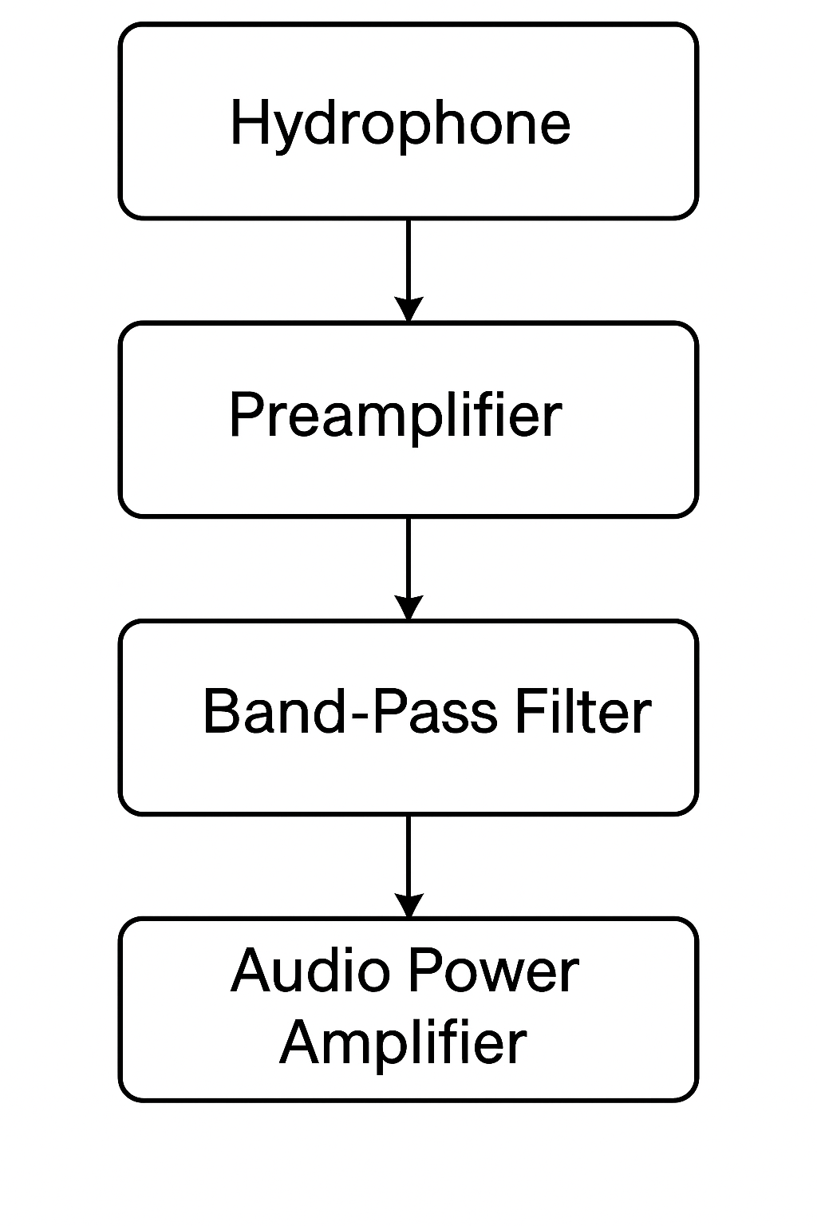
Stage 1
Stage 2
Stage 3

Slide 5
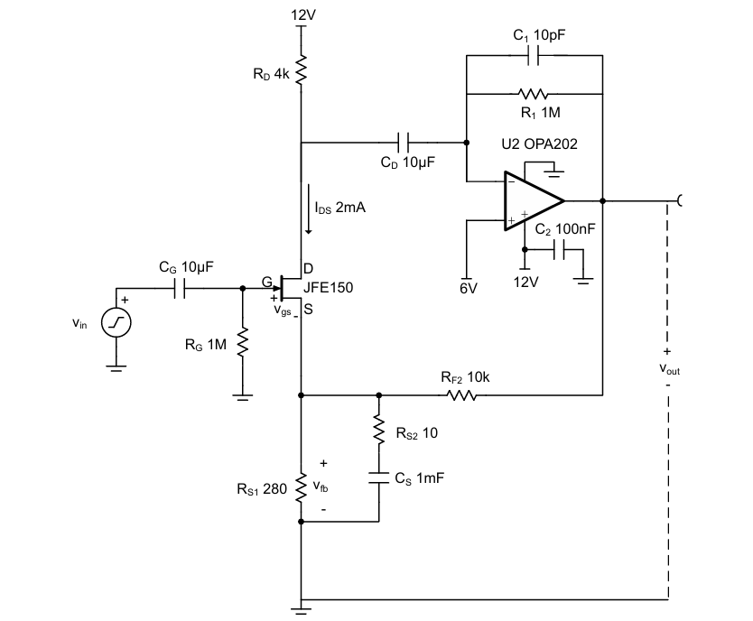
Stage 1 : Preamplifier
TI JFE150 & OPA202
Ultra-Low Noise & High Gain Offers extremely low input-referred noise and a closed-loop gain of 60 dB, making it perfect for amplifying weak microvolt-level signals from hydrophones.
High Input Impedance Prevents loading the high-impedance hydrophone signal, ensuring signal integrity and minimal distortion.
Wide and Stable Frequency Response Provides flat amplification from 16 Hz to 43 kHz with a stable phase margin of 87.4°, fully covering the underwater communication band (10–20 kHz).
Op-Amp Integration for Precision Paired with OPA202 op-amp for stable, low-noise amplification—avoiding the limitations of bipolar op-amps in high-impedance applications.

Slide 6
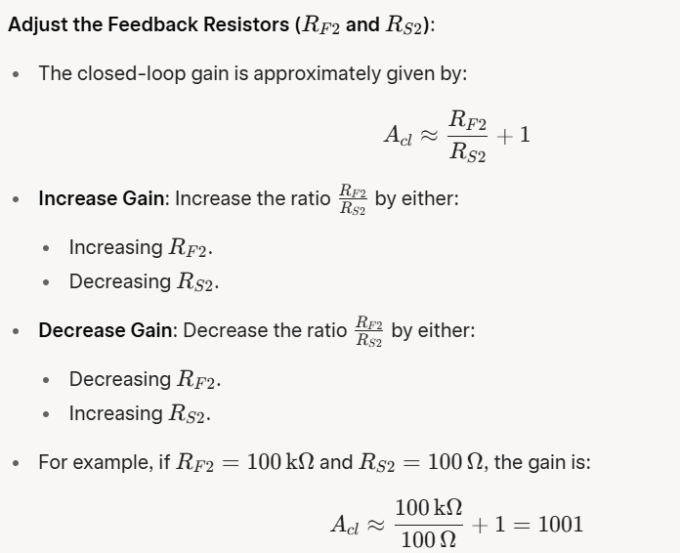
Gain of the Preamp stage: ( Gain ~ 60 dB )

Slide 7
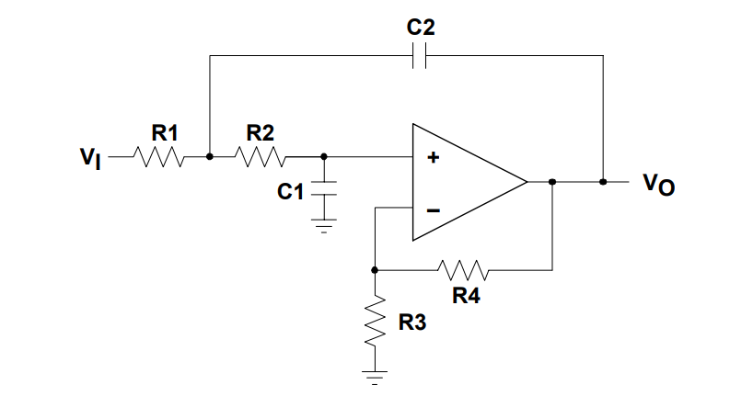
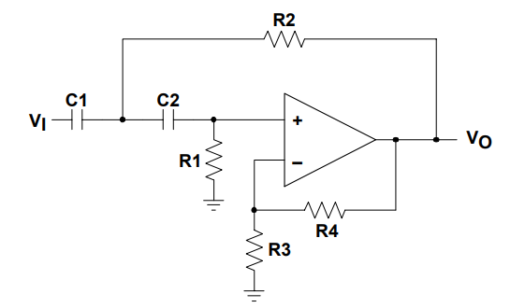
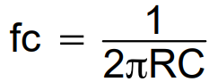
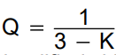
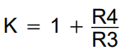
Stage 2 : Band-pass filter
Low-Pass Sallen-Key Circuit
Set Filter Components equal:
Letting R1=R2=R and C1=C2=C
High-Pass Sallen-Key Circuit
Set Filter Components equal:
Letting R1=R2=R and C1=C2=C

Slide 8
In underwater environments, signal levels are tiny. The Sallen-Key filter, paired with low-noise op-amps, introduces very little additional noise, making it ideal for amplifying weak hydrophone signals.
By simply , just cascading the Low pass filter and High pass filter , we achieve a band pass filter.
In underwater environments, signal levels are tiny. The Sallen-Key filter, paired with low-noise op-amps, introduces very little additional noise, making it ideal for amplifying weak hydrophone signals.
It can be tuned accurately within the 10 Hz to 20 kHz audio range, which matches the underwater communication band.
can get sharp roll-off without affecting useful audio.

Slide 9
Stage 3 : Power-Amplifier
TI TPA3116D2
Class-D Operation with PWM Switching . The TPA3116D2 uses high-frequency Pulse Width Modulation (PWM) to amplify audio or signal inputs efficiently. Instead of linearly boosting voltage like Class A/B amps, it switches transistors fully ON or OFF, minimizing heat and power loss.
High Output Power with Efficiency, Capable of delivering up to 2 × 50W into 4Ω loads, it achieves >92% efficiency.
This is ideal for embedded and battery-powered systems like underwater acoustic devices, as it avoids the need for large heatsinks.
Integrated LC Output Filter for Clean Signal. An LC low-pass filter at the output reconstructs a smooth analog signal from the PWM pulses and suppresses high-frequency switching noise, ensuring clean, safe driving of speakers or transducers.
Gain is hardware-configurable via resistors, with preset options of 20/26/32/36 dB.

Slide 10
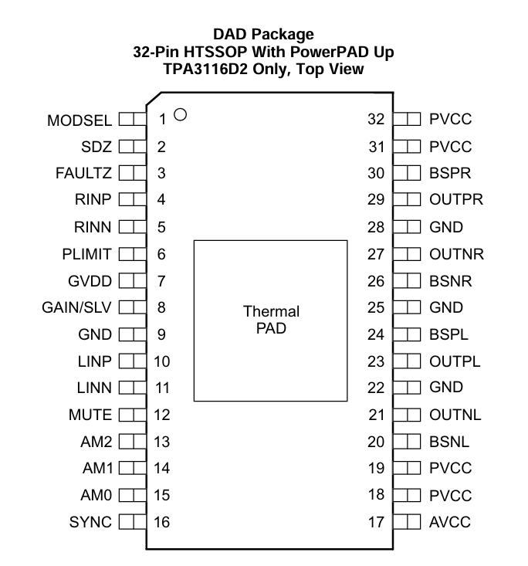
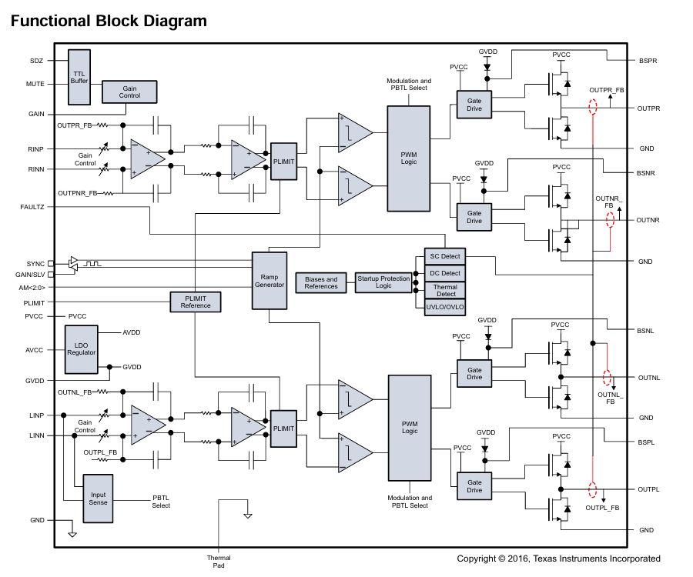

Slide 11
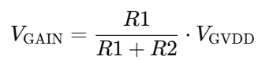
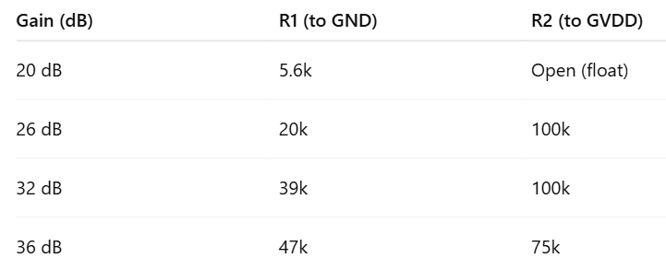
GVDD = 7V (internal regulator output)
Gain of the power amplifier:
GVDD (Pin 7)
|
R2
|
GAIN/SLV (Pin 8)
|
R1
|
GND
That voltage is set by the voltage divider formed by R1 and R2:
GVDD = 7V (internal regulator output)
Note: Keep resistor values in the kΩ range (too low = power waste, too high = noise)

Slide 12
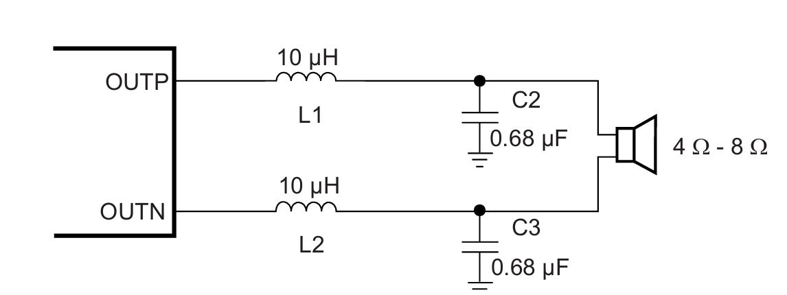
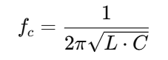
LC Output Filter for Clean Signal
Speaker
Removes switching noise
Reconstructs a clean analog waveform across the speaker.
So we design it as a low-pass filter, with a cutoff frequency (fc):
Pick:
fc=1.5 × max signal frequency
So, we take fc= 1.5 x 20kHz

Slide 13
Speaker Operation with Differential Outputs
1. Bridge-Tied Load (BTL) Drive: Each speaker is connected between two outputs (e.g., OUTPL and OUTNL). These outputs swing in opposite phases, creating a voltage difference across the speaker — even though neither side is tied to ground.
Increased Output Swing and Power: This differential swing effectively doubles the voltage across the speaker, delivering 4× the power compared to single-ended drive. The result is stronger, cleaner sound or signal transmission, ideal for underwater acoustic applications.

Slide 14
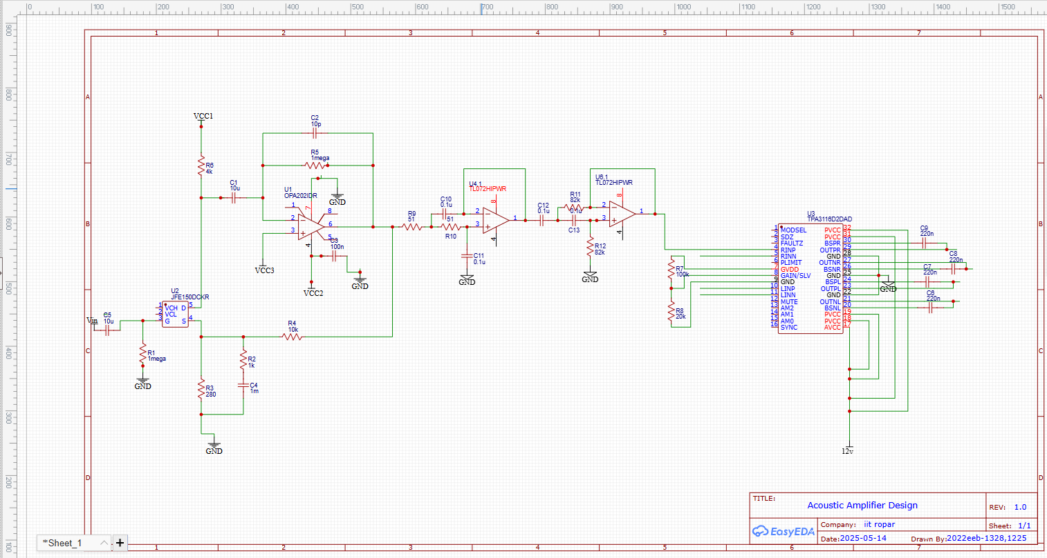
Schematic layout design of entire 3 stages:

Slide 15
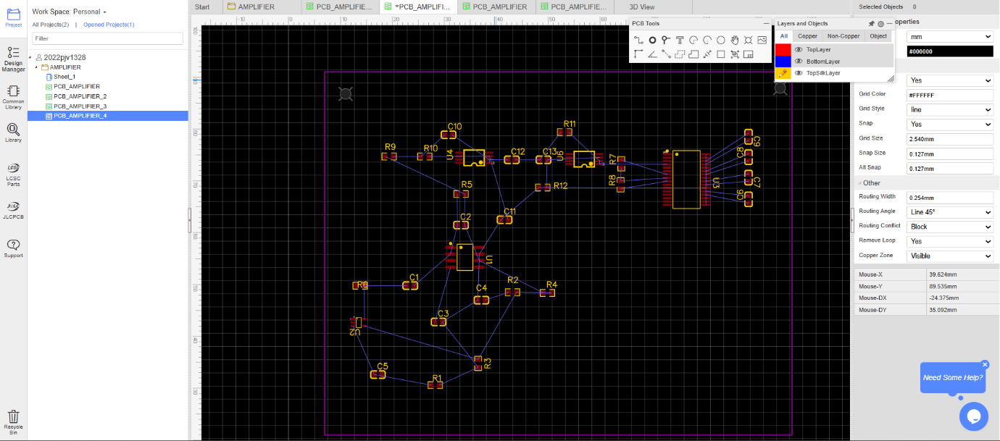
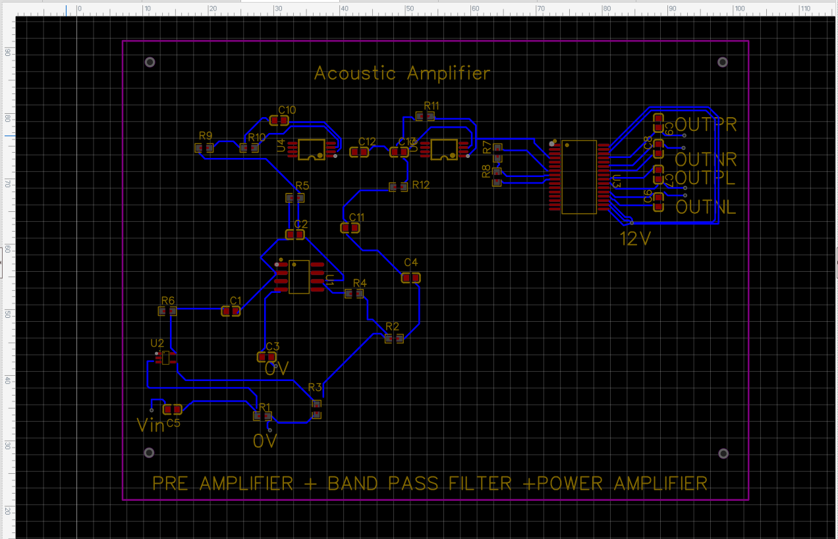
Implementing Power Amplifier Circuit in EasyEDA PCB Design

Slide 16
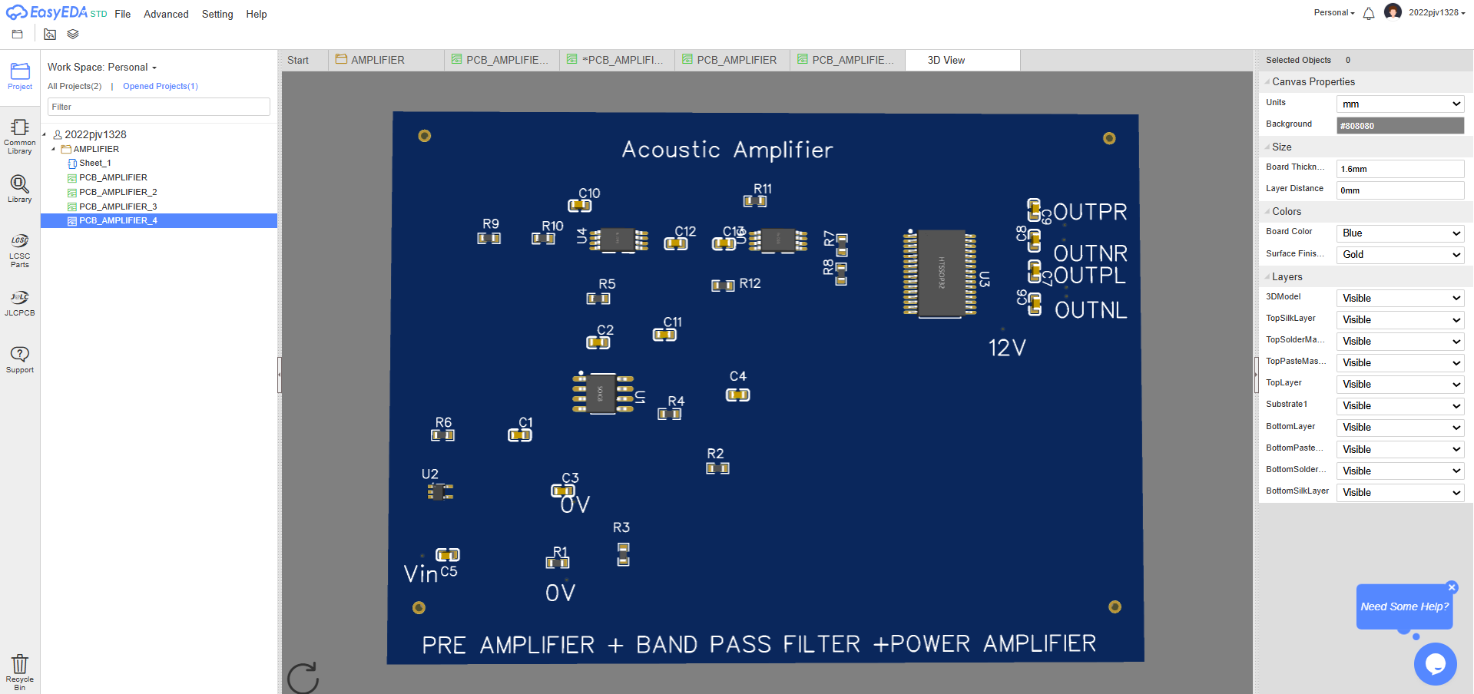
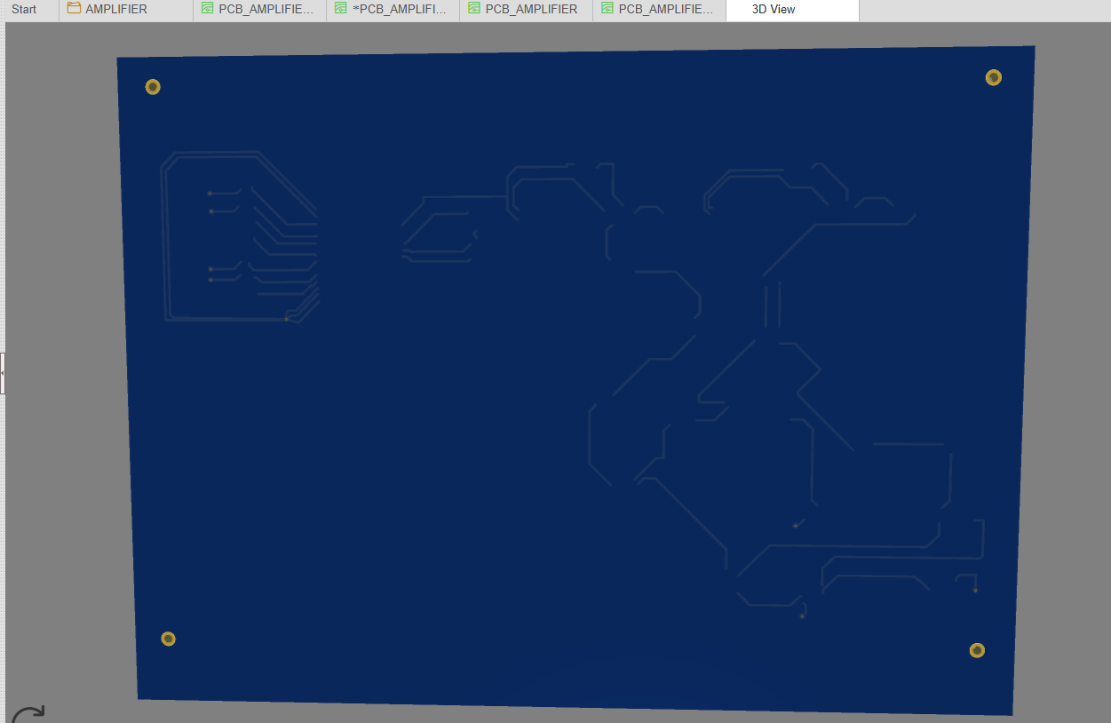
3D LAYOUT OF PCB:
Back view
Front view

Slide 17
Conclusion and Future Work
This project successfully designed an acoustic amplifier system integrating the TI JFE150 preamplifier, a 4th-order Sallen-Key bandpass filter, and the TI TPA3116D2 Class-D power amplifier.
Simulation results , validate the system's performance, and PCB layouts are finalized for manufacturing.
Next steps include:
Hardware prototyping and assembly.
Underwater acoustic testing for real-world validation.
Impedance matching refinement to maximize signal efficiency.

